Slide 1
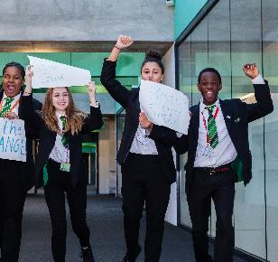
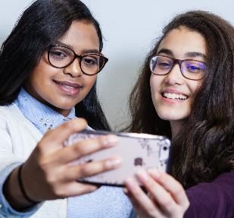
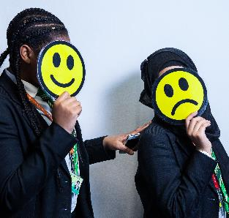
The Power of Image

Slide 2
Learning Intentions
I will;
understand what is meant by cyberbullying
recognise the impact that cyberbullying can have on people
reflect on my own behaviours online in order to help myself and others
learn the strategies to avoid getting into or contributing to negative situations online.”

Slide 3
There are now more ways than ever before to create, edit and share images and videos online.

Slide 4
Did you know…
On Instagram, photos showing faces are 38% more likely to get ‘likes’ than photos without faces
Images and videos get 8,500 likes and 1,000 comments per second on Instagram
400 million snaps are sent on Snapchat each day
The equivalent of 110 years of live video is watched on Periscope every day.
300 million photos are uploaded to Facebook every day

Slide 5
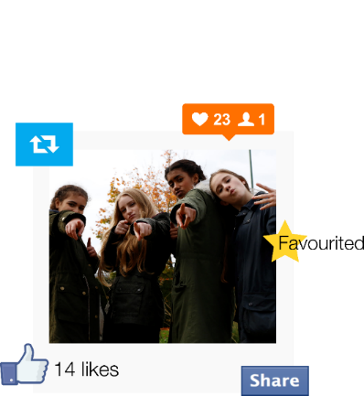
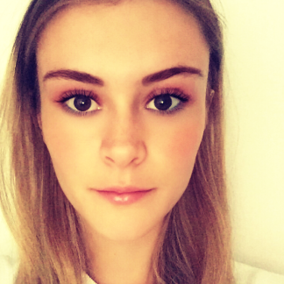
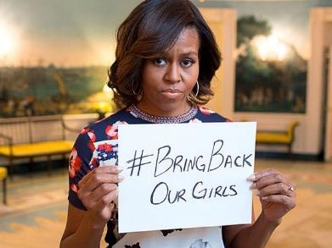
Why do people share images?
To share memories
To get noticed? (likes and followers)
To show people what you are up to
To raise awareness
To boost confidence?

Slide 6
Internet Safety Quiz
The questions will be read out and you record your answer – a,b or c in your jotter
Class discussion – discuss the answers and share your thoughts and opinions

Slide 7
Watch this 14 mins clip and record dangers of web use and ideas on how to keep safe Cut and paste link into you tube
Newsround
Caught Up in the web
https://www.youtube.com/watch?v=kgCNGvL0g1g

Slide 8
Top 10 Tips to Internet Safety
In your jotter, start a list
1
2
3
4
5
6
7
8
9
10
Watch You Tube Clip
Cut and paste link into you tube
https://www.youtube.com/watch?v=ml2bVJf15Bw
ADD them to your list
Do you have more than 10 ?

Slide 9
Top Ten Tips
 | TIPS
1 | Ask a grown up for advice setting up
2 | Do not give personal details
3 | Do not send pictures to people you do not know
4 | When on social media/chatroom use a nickname
5 | Delete messages from strangers/sites you do not recognise
6 | Do not communicate with strangers
7 | Report a concern to an adult if you feel threatened
8 | Treat others as you would like to be treated
9 | Be careful what you write
10 | REPORT ABUSE, call 101

Slide 10
Activity – Heads and Tails
What happens next?
You will have a sheet to copy from and then we can discuss as a class

Slide 11
COPY the scenarios into your jotter

Slide 12
Should I share it? Yes or no?
As a class READ through the Decision tree flowchart
TASK
You will be creating a decision tree for sharing images online. Your tree will need to take on board what you have learnt in the previous two activities and include a range of scenarios or pointers
people should consider along with clear advice about the

Slide 13
App 3b will help you
Suggested questions:
• Is it a good photo? (initial question)
• Are other people in the photo?
• Have I asked permission?
• A year from now will I be happy this picture is online?
• Would I want my grandparent to see this picture?

Slide 14
Think of the last image you posted

Slide 15
Ask yourself …
1. Who saw this post at the time and who could see it now?
2. Would everyone understand the image or could it be misleading?
3. If it was about someone, would you have said it to their face?
4. If your post went viral would you be happy?
5. Are you happy for this to be part of your digital footprint?

Slide 16
Unfortunately not all images on the internet are positive, but what can we do if we see something which worries or upsets us?
Always report inappropriate or offensive images to the networks but looking out for the report buttons!

Slide 17
We want to make sure all of those images we post on the internet are positive!
But how can we do that?
Think before you post!
Ask permission from the other people in the image!
Think – is my image misleading?
Think – could my image upset anyone?
Lock down privacy settings!

Slide 18
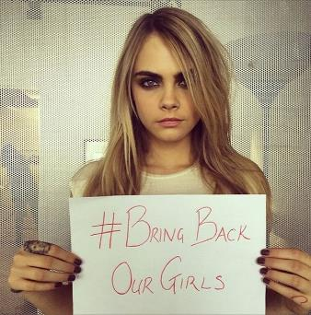
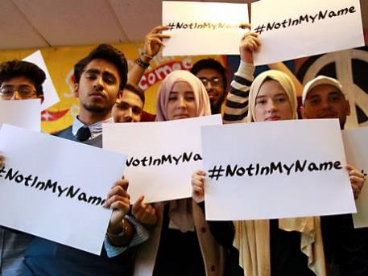
Remember images are powerful. They can …
Tell a story
Send a message
Provoke emotion
Create a memory
Use them wisely!

Slide 19
Internet Safety
Using the information discussed and gathered in class you can complete and internet safety poster highlighting
Safe Use
Dangers
Your own tips for internet safety
WEBSITES
www.projectchildsave.org/InternetSafety
www.safetynetkids.org.uk/personal-safety/staying-safe-online
www.thinkuknow.co.uk/11_13
www.saferinternet.org.uk/safer-internet-day/2017

Slide 20
Can we do this on our own?
No! Today is all about working together to make a change.
So …

Slide 21
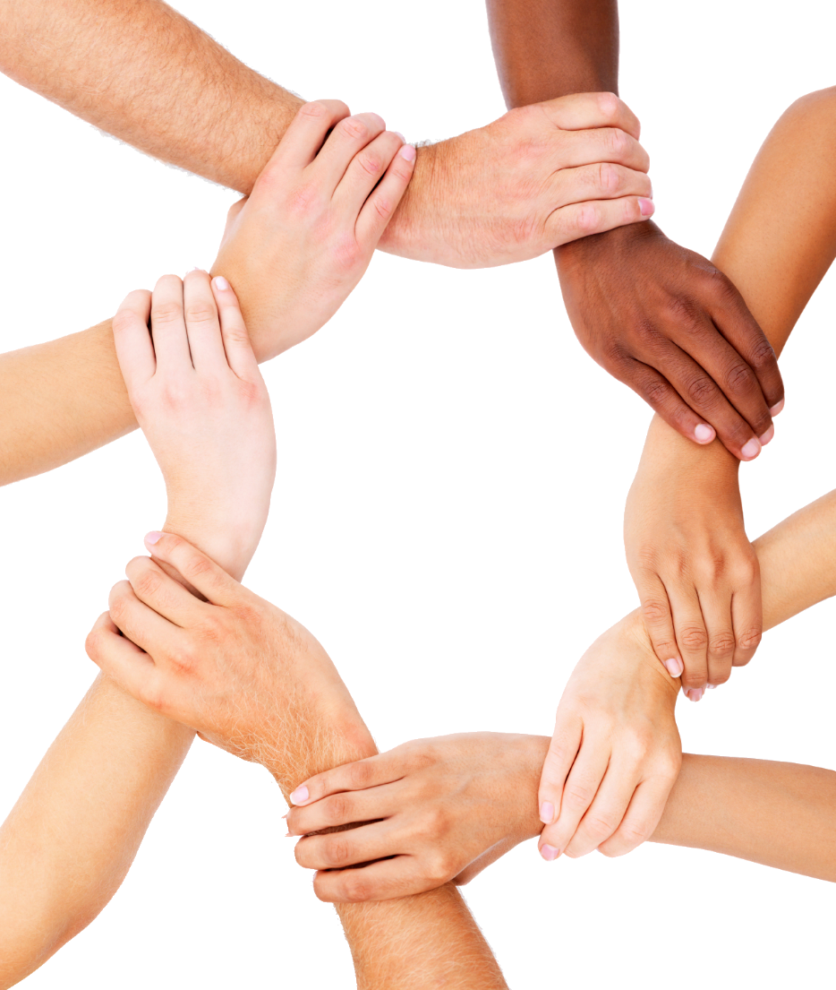
Be the change: Unite for a better internet

