Slide 1
S2 Course Choice New Courses

Slide 2
Science
This course provides a basic introduction to science with an emphasis on scientific skills. It is made up of three units linking with each of the fundamental sciences.
1. Life Sciences:
Basic biology concepts, including living organisms and their environment.
Introduction to human health and the impact of lifestyle choices.
2. Earth Sciences:
Topics such as the Earth’s resources, the environment, and sustainability.
3. Physical Sciences:
Basic principles of chemistry and physics, including energy, forces, electricity, and space exploration.

Slide 3
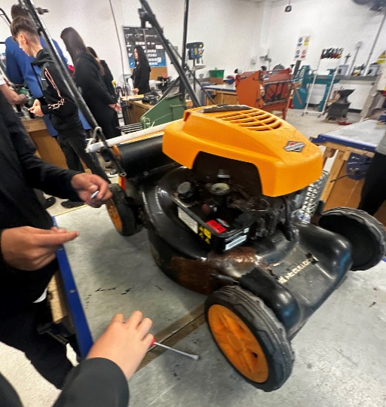
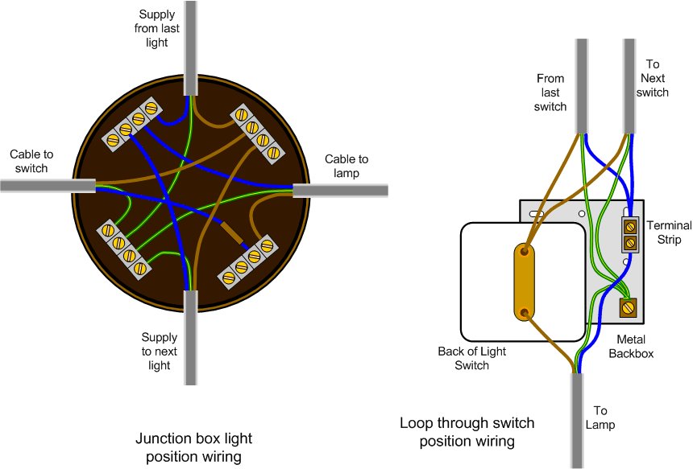
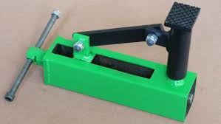
ENGINEERING SKILLS
FABRICATION
MAINTENANCE
DESIGN & MANUFACTURE
ELECTRICAL / ELECTRONIC
This course will provide the broad practical skills base needed in engineering manufacturing systems and processes. Learners will develop the skills and knowledge necessary for basic engineering processes and maintenance, working on a range of engineering systems including fitting using hand skills, fabrication engineering, manufacturing project design and electrical and electronic engineering. The course supports progression into other engineering studies, training or employment. The course provides the basis that allows candidates to gain insight into other engineering occupations such as mechanical, fabrication, automotive, electrical and electronic. The subjects you study will help you to decide the career path that you wish to take in the future.

Slide 4
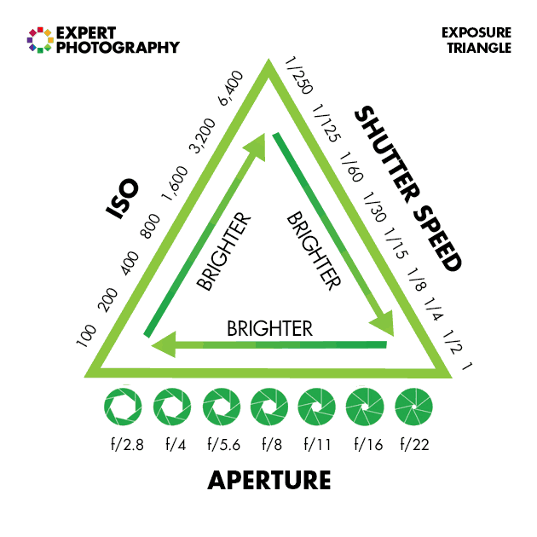
PHOTOGRAPHY
UNDERSTANDING PHOTOGRAPHY
PHOToGraphing
People
PHOToGraphing
PLACES
WORKING WITH PHOTOGRAPHS
Covering and developing your skills in portraiture, landscape and studio photography this course will introduce the manual controls of your camera and give you experience researching, making and presenting your photographs.
Assessment is through units and portfolio – no exam.

Slide 5
Games Design
Game design and development fundamentals
Hands-on experience with game creation tools
Topics like storytelling, character design, and game mechanics

